Slide 1
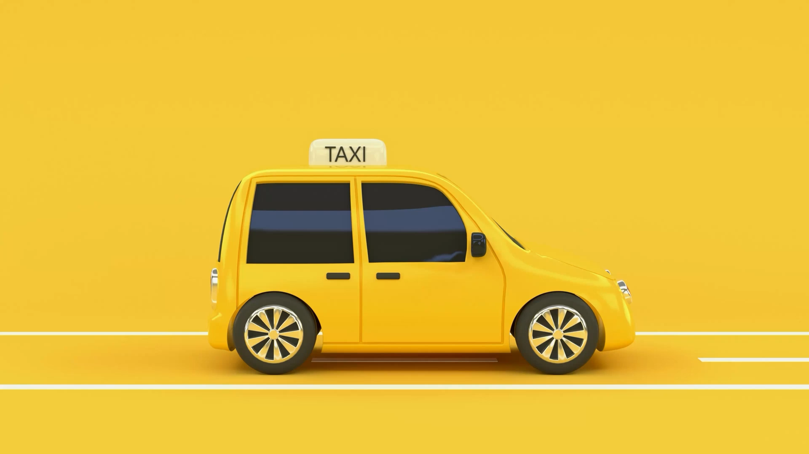
DriverHero: The Ultimate Voice Assistant for Taxi Drivers
Team10

Slide 2


Slide 3
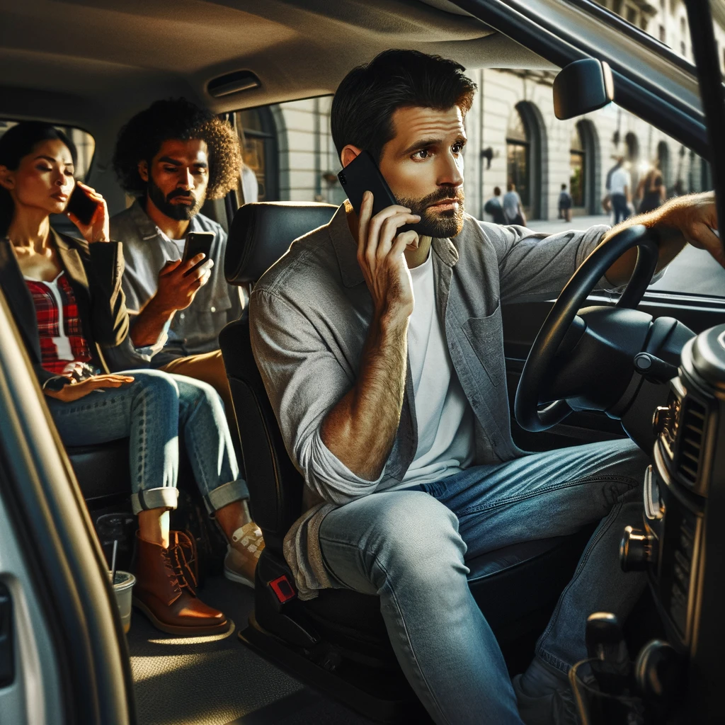

Slide 4
Components
Speech to text
Entity recognition
Text to speech
Moovex API integration
React frontend

Slide 5

Speech to Text
Google Speech to Text
Send wav file to endpoint
Receive json of the identified text

Slide 6
Entity recognition
Rasa
Spacy
ChatGPT

Slide 7
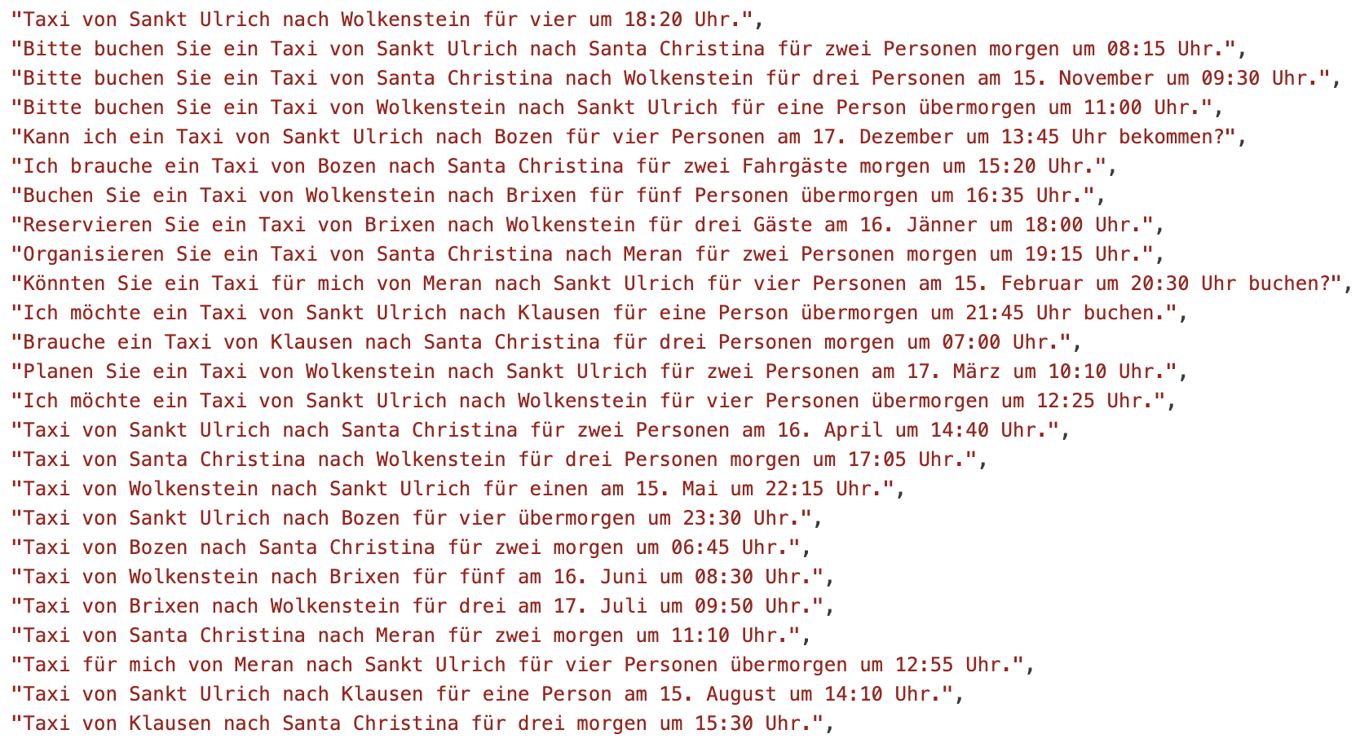

Slide 8
{
"departure": "Bozen",
"destination": "Meran",
"no_of_people": 1,
"when": {
"date": "heute",
"Uhrzeit": "14:00"
}

Slide 9
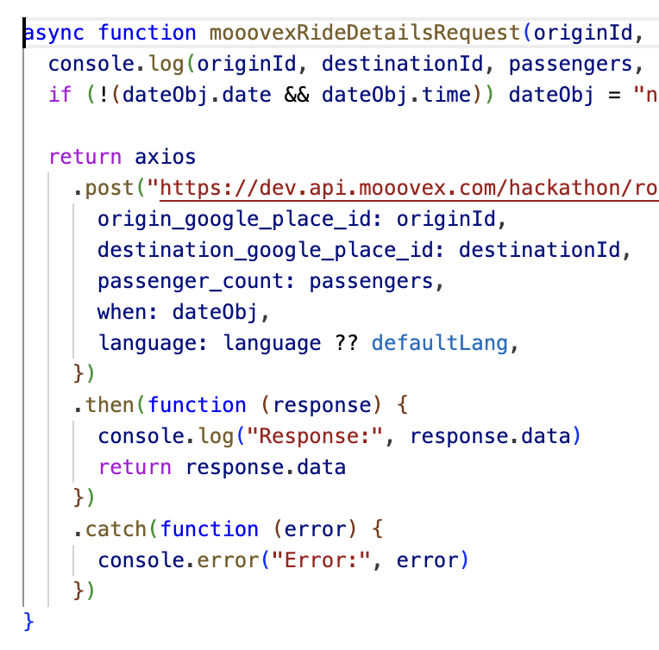
Moovex API integration
Taxi fahrt wird in Moovex hinzugefügt

Slide 10

Text to speech
Google Text to SpeechText

Slide 11
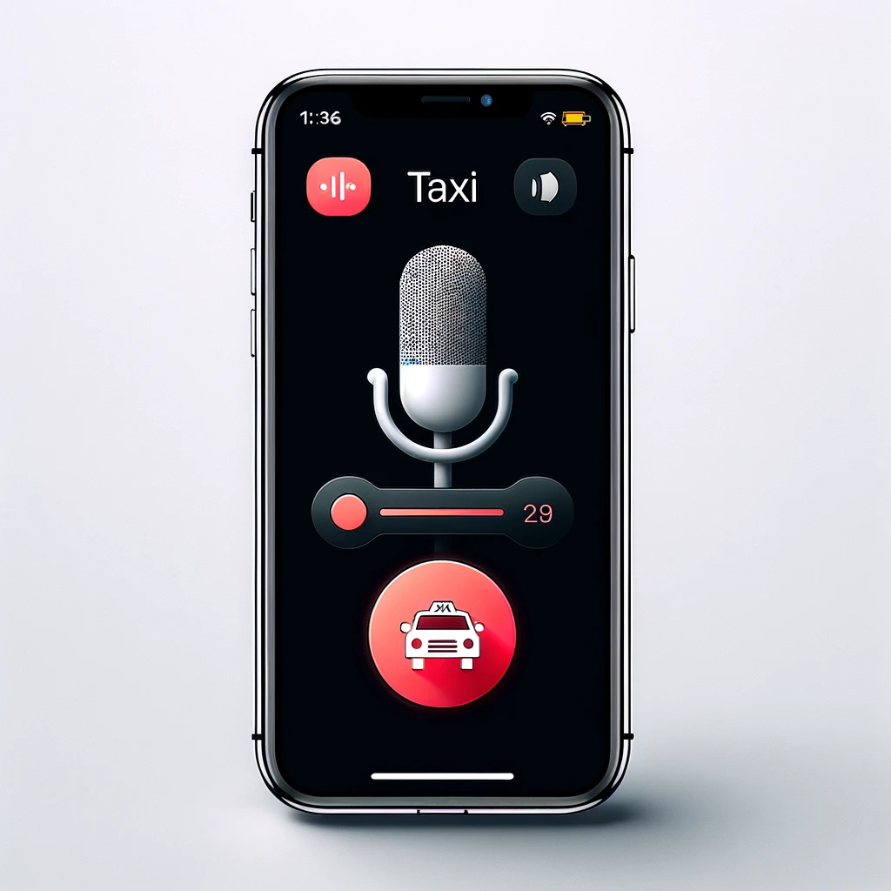
Our dream UI

Slide 12
Thank you for your attention!
Team10

